Slide 1
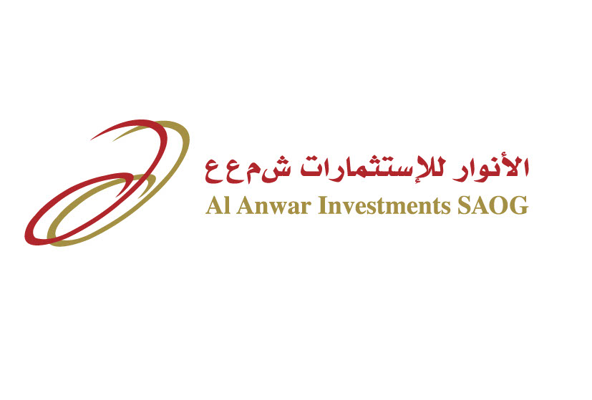
Al Anwar Investments SAOG
Presentation on Financial Statements
For the six month period ended on 30th September 2023

Slide 2
Investment Portfolio
S. No. | Name of Company | % Stake | Carrying Value (OMR) | % of CV
A. | Associate - Group Carrying Value |  | 31,750 | 64.7%
A-1 | Oman Chlorine SAOG | 22.11% | 8,042 | 16.4%
A-2 | National Detergent SAOG | 25.24% | 5,354 | 10.9%
A-3 | Arabia Falcon Insur. SAOG | 22.62% | 4,836 | 9.9%
A-4 | Alruwad School SAOC | 43.51% | 4,675 | 9.5%
A-5 | Voltamp Energy SAOG | 24.68% | 4,103 | 8.4%
A-6 | Al Maha Ceramics SAOG | 18.74% | 2,442 | 5.0%
A-7 | National Biscuit SAOG | 29.22% | 2,258 | 4.6%
A-8 | Hormuz Cement SAOC | 40.00% | 40 | 0.1%
B. | Investment at Fair Value- Group Carrying Value |  | 14,327 | 29.2%
B-1 | Bank Dhofar SAOG | 1.50% | 7,649 | 15.6%
B-2 | DIDIC | 6.73% | 6,602 | 13.5%
B-5 | Others |  | 76 | 0.2%
C. | Property and other assets |  | 2,308 | 4.7%
D. | Receivable and cash |  | 682 | 1.4%
 | Total |  | 49,067 | 100%

Slide 3
Portfolio Sector Allocation
% of industrial sector has reduced to 45% due to partial exit in AMC
% banking sector has increased to 16% of the portfolio due to investment in Bank Dhofar

Slide 4
Al Anwar Performance– YTD Sept’23
Income (OMR’000)
Expenses (OMR'000)
Net Profit & Other Comp. Income (OMR’000)
Performance Overview
The company reported a net profit of OMR 898k for the six-month period ending on September 30, 2023, compared to a net loss of OMR 651k reported last year. This positive result is primarily due to a fair value gain of OMR 1,003k generated on the company’s marked-to-market investments and a realized gain of OMR 342k on the sale of AAI stake in Almondz Global Securities Ltd, India, which was classified at fair value.
The total comprehensive income for the period was OMR 2,753k, compared to a loss of OMR 218k for the last year. This improvement is primarily as a result of a fair value gain of OMR 1,348k recorded on investments classified as Fair Value through Other Comprehensive Income (FVOCI).
The share of profit from associate has declined by 52% compared to last year, mainly affected by the performance of Al Maha and Alruwad School.
The increase in administrative expenses during the current year is mainly on account of the appointment of an additional staff member
The company earned interest income on its investment in Ominvest Bonds in Q1 of 2023 and In 2023. The decline is primarily due to the sale of Bonds and the redemption of the Bonds that took place on 6th June 2023.

Slide 5
Financial Overview – Balance Sheet
Particulars | 30-Sep-23 | 31-Mar-23 (Audited)
Assets
Investment in Associates | 31,750 | 31,048
Investments at fair value | 14,327 | 14,176
Property & other assets | 2,308 | 2,308
Receivables and prepayments | 178 | 1,116
Cash and Bank Balance | 504 | 183
Total Assets | 49,067 | 48,831
Equity
Share Capital | 20,600 | 20,000
Legal Reserve | 4,603 | 4,603
Fair Value reserve | 3,007 | 1,152
Retained Earnings | 4,849 | 5,551
Total Equity | 33,059 | 31,306
Liabilities
Bank Borrowings | 15,625 | 17,142
Payables | 383 | 383
Total Liabilities | 16,008 | 17,525
Total equity and liabilities | 49,067 | 48,831
Net assets per share (in Baiza) | 160 | 157

Slide 6
Bank Borrowing
Debt Equity Ratio
Management Comments
Interest rates have increased during last year, due to the increase in rates globally.
Effective Rate of Interest
Particulars (OMR’000) | Sept-22 | Sept-23
Actual outstanding | 18,163 | 15,625
Interest cost | 497 | 507
Range of Interest Rates | 5.50% - 6.50% | 5.00% - 6.50%
Effective rate of Interest | 5.70% | 5.91%

Slide 7
Performance of Associate Companies – June’23 (6M)
Revenue (OMR’000)
Net Profit (OMR'000)
Share of Profit (OMR’000)
Management Comments
All of our Associate Companies, except Alruwad School, are listed companies. Investors and financial analysts can obtain more details from MSX.
The performance of Voltamp, NDC, and NABIL has improved compared to last year, reporting better profits. On the other hand, Al Maha, Alruwad School, Oman Chlorine, and Arabia Falcon reported either losses or lower profits compared to last year.
A major decline was noted in the performance of Al Maha due to a share of loss of OMR 786,721 recorded from its newly acquired associate, Al Hael Ceramics LLC, and a decline in revenue due to increased competition from low-cost imported tiles in the GCC and the impact of new customs duties in KSA.
Alruwad School has reported lower revenue and a loss for the six-month period ending on July 31, 2023. This is primarily due to a lower number of students enrolled in the school during the academic year. The school has signed an agreement with Ellesmere, UK, and we expect that the school's performance will improve in the coming years.
Oman Chlorine has underperformed mainly due to lower selling prices of Caustic products and increased cost of borrowing of its subsidiaries in Qatar and UAE.
The increase in total claims affected the performance of Arabia Falcon.

Slide 8
Thank You

